Slide 1
More Statistical Inference

Slide 2
Review
Let event D = data we have observed.
Let events H₁, …, H_{k} be events representing hypotheses we want to choose between.
Use D to pick the "best" H.
There are two "standard" ways to do this, depending on what information we have available.

Slide 3

Maximum likelihood hypothesis
The maximum likelihood hypothesis (H^{ML}) is the hypothesis that maximizes the probability of the data given that hypothesis.
How to use it: compute P(D | H_{i}) for each hypothesis and select the one with the greatest value.

Slide 4
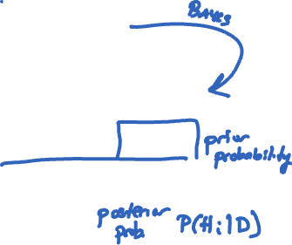
Maximum a posteriori (MAP) hypothesis
The MAP hypothesis is the hypothesis that maximizes the posterior probability:
The P(D | H_{i}) terms are now weighted by the hypothesis prior probabilities.

Slide 5


One slide to rule them all
The maximum likelihood hypothesis is the hypothesis that maximizes the probability of the observed data:
The MAP hypothesis is the hypothesis that maximizes the posterior probability given D:
P(H_{i}) is called the prior probability (or just prior).
P(H_{i}|D) is called the posterior probability.

Slide 6

There are 3 robots.
Robot 1 will hand you a snack drawn at random from 2 doughnuts and 7 carrots.
Robot 2 will hand you a snack drawn at random from 4 apples and 3 carrots.
Robot 3 will hand you a snack drawn at random from 7 burgers and 7 carrots.
Suppose your friend goes up to a robot (you don’t see this happen) and is given a carrot. Which robot did your friend probably approach?
What if the prior probability of your friend approaching robots 1, 2, and 3 are 20%, 40%, and 40%, respectively?

Slide 7
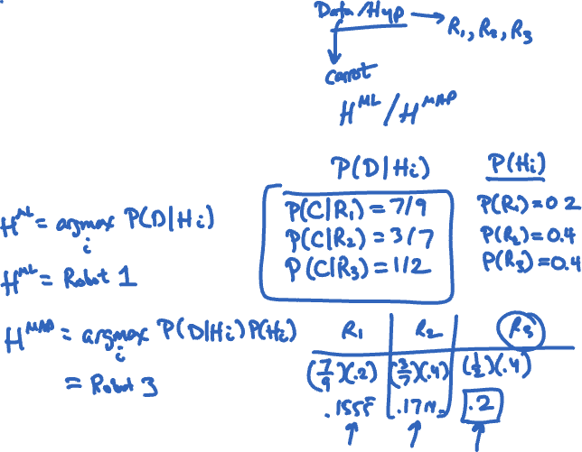
There are 3 robots.
Robot 1 will hand you a snack drawn at random from 2 doughnuts and 7 carrots.
Robot 2 will hand you a snack drawn at random from 4 apples and 3 carrots.
Robot 3 will hand you a snack drawn at random from 7 burgers and 7 carrots.
Suppose your friend goes up to a robot (you don’t see this happen) and is given a carrot. Which robot did your friend probably approach?
What if the prior probability of your friend approaching robots 1, 2, and 3 are 20%, 40%, and 40%, respectively?

Slide 8
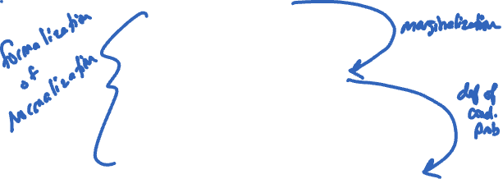
Probability vs hypothesis
Sometimes you only care about which hypothesis is more likely, and sometimes you need the actual probability.

Slide 9
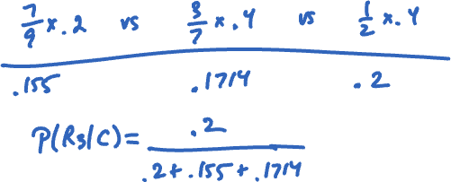
In the robot problem, what is P(R3 | C)?

Slide 10
Probability vs hypothesis
In the robot problem, what is P(R3 | C)?
= (7/9 * 2/10) / (7/9 * 2/10 + 3/7 * 4/10 + 1/2 * 4/10) =~ 0.2952

Slide 11
Posterior probability
If you need the actual posterior probability:

Slide 12
A patient comes to visit Dr. Gregory House because they have a cough. After insulting and belittling the patient, House consults with his team of diagnosticians, who tell him that if a patient has a cold, then there’s a 75% chance they will have a cough. But if a patient has the Ebola virus, there’s a 80% chance they will have a cough.
What is the maximum likelihood hypothesis for the diagnosis?

Slide 13
A patient comes to visit Dr. Gregory House because they have a cough. After insulting and belittling the patient, House consults with his team of diagnosticians, who tell him that if a patient has a cold, then there’s a 75% chance they will have a cough. But if a patient has the Ebola virus, there’s a 80% chance they will have a cough.
What is the maximum likelihood hypothesis for the diagnosis?

Slide 14
After concluding the patient has Ebola, House fires all his diagnosticians for their poor hypothesis testing skills and hires new ones. This new team does some background research and discovers if they are only going to consider the common cold and Ebola, then before the symptoms are even considered, there’s a 1% chance the patient has Ebola and a 99% chance they have a cold.
What is the MAP hypothesis for the diagnosis? What is the posterior probability the patient has Ebola?

Slide 15
Suppose I work in FJ in a windowless office. I want to know whether it's raining outside. The chance of rain is 70%. My colleague walks in wearing his raincoat. If it’s raining, there’s a 65% chance he’ll be wearing a raincoat. Since he’s very unfashionable, there’s a 45% chance he’ll be wearing his raincoat even if it’s not raining. My other colleague walks in with wet hair. When it’s raining there’s a 90% chance her hair will be wet. However, since she sometimes goes to the gym before work, there’s a 40% chance her hair will be wet even if it’s not raining.
What’s the posterior probability that it’s raining?

Slide 16
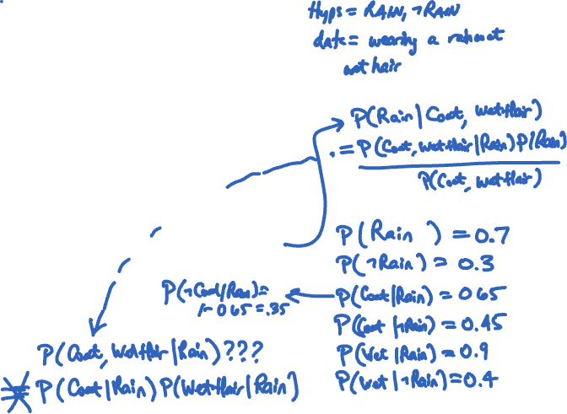
Suppose I work in FJ in a windowless office. I want to know whether it's raining outside. The chance of rain is 70%. My colleague walks in wearing his raincoat. If it’s raining, there’s a 65% chance he’ll be wearing a raincoat. Since he’s very unfashionable, there’s a 45% chance he’ll be wearing his raincoat even if it’s not raining. My other colleague walks in with wet hair. When it’s raining there’s a 90% chance her hair will be wet. However, since she sometimes goes to the gym before work, there’s a 40% chance her hair will be wet even if it’s not raining.
What’s the posterior probability that it’s raining?

Slide 17

We can't solve this problem because we don’t have any information about the probability of Colleague 1 wearing a raincoat and Colleague 2 having wet hair occurring simultaneously.
We don't know P(C, W | R).
Let's make an assumption that C and W are conditionally independent given that it is raining (or not raining).
P(C, W | R) = P(C | R) * P(W | R)
(and similarly for given ~R)

Slide 18
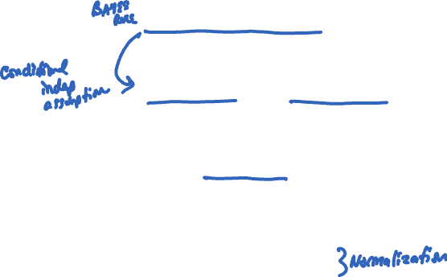
Combining evidence
It is very common to make this independence assumption for multiple pieces of evidence (data).
where
Notes:
P(D_1\ldots, D_m) = \sum_{i=1}^k \Big(\prod_{j=1}^m P(D_j\mid H_i)\Big)P(H_i)

Slide 19



This can be dangerous!

Slide 20


Slide 24

Spam classification
Suppose you have an email and you want to know if it's spam or not.
In general, the probability of an email being spam is 20%.
Suppose you have a big list of words that "suggest" spam, like viagra, cialis, cash, ...
You have access to a large number of old emails that are correctly categorized as spam or not-spam.

Slide 25
Two hypotheses: spam and not-spam.
You know P(spam) and P(not-spam).
Suppose your word list has m words in it.
Our newly-observed email (our evidence/data) is the joint event W₁, W₂, …, W_{m} where each W_{i} is true or false if the word is in the email or not.
Let's assume the words are all conditionally independent given the label (spam/not-spam), and that we can compute P(W_{i}|spam) and P(W_{i}|not-spam).

Slide 26
The equation above is the basis for a probabilistic model called a Naïve Bayes Classifier.

